Slide 1
Amdocs MS Suite Demo
Ramgopal

Slide 2
Stateless MicroServices

Slide 3
Set up
Central Servers
Config server – 1 instance
Eureka Discovery Server – 1 instance
Zuul Gateway Server – 1 instance
Zipkin Distributed Tracing Server -1 instance
Customer Management MS – 3 instances
Ordering Management MS – 3 instances
Billing Management MS – 3 instances

Slide 4
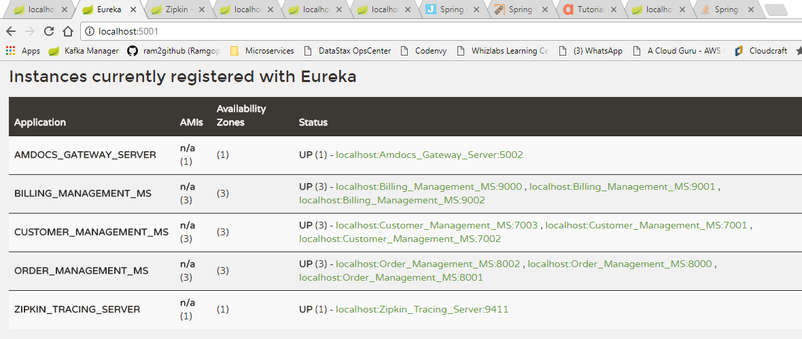
Eureka Discovery Server

Slide 5
Zuul API Gateway
Port : 5002
Customer Management MS
Customer Management MS
MS
Customer Management MS
Customer Management MS
Customer Management
3 instances
Port: 7000,7001,7002
Order Management
3 instances
Port : 8000,8001,8002
Billing Management
3 instances
Port : 9000,9001,9002
Config Server
Port : 5000
Discovery Server
Port:5001
Zipkin Tracing Server
Port :9411

Slide 6
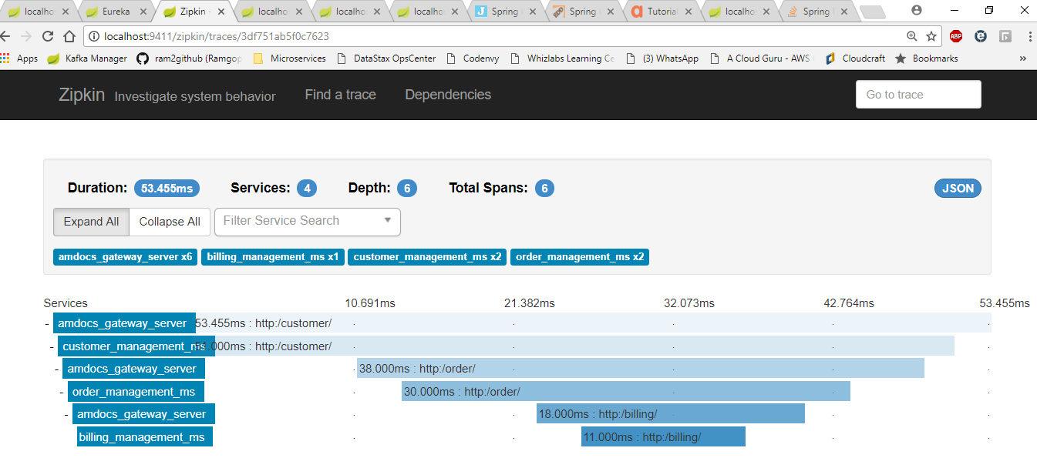
ZipKin Tracing Server

Slide 7
Observation
Central Servers are SPOF !
TODO : build clusters for config / Disovery / gateway / Zipkin
Need to understand the BEST practice here !!!
Hystrix implemented for failover
Only implemented in Ordering →Billing to illustrate the effect of Ordering Failure vs Billing Failure
API gateway used even for internal redirects
No hardcoding of URLS
Lookup Discovery server from Eureka ( no hardcoding here as well)
Use “route” filter to create a custom Loadbalanced Request filter for redirection
Use ribbon for laodbalancing
No topology knowledge about other MS
Customer MS is not aware of # of instances of Ordering or their URLs

